Slide 1
Structures
A structure can be used to define a new data type that contains items that logically belong together, even if the items are of different types
Structures must be defined before use
Defining a struct simply tells the compiler what the new data type looks like; it does not cause any storage space in memory to be reserved for anything until you declare a variable of that type
Notes:
C structures allow us to combine one or more existing data types into a new data type. The definition is like a template or blueprint and is composed of members that are previously defined types. When you actually allocate memory for the structure, as when you declare a variable of the new type, the template describes the structure of the memory allocated.
Like a header that must be defined before you use or call a function, a structure type has to be defined before you can declare a variable of that type.

Slide 2
Structures
C has three different methods to define a structure
tagged structures
variable structures
type-defined structures
Notes:
C provides three ways to define a structure.

Slide 3
1) Tagged Structure
A tagged structure definition defines a type
We can use the tag to define variables, parameters, and return types
Variable declarations:
Variables point1, point2, and point3 all have members x and y.
Structure tag
Member names
DON’T FORGET THE SEMICOLON
Notes:
If we want to define multiple variables of the same structure, we can use this method, a tagged structure.
You must use struct and your tag when defining variables, parameters, or return types.

Slide 4
2) Struct variable
A variable structure definition declares a struct variable
Member names
Variable name
DON’T FORGET THE SEMICOLON
Notes:
This method only allocates a single variable that is a structure.

Slide 5
3) Typedef Structure
A typed-defined structure allows the definition of variables without the struct keyword.
We can use the type name to define variables, parameters, and return types.
Variable declaration:
Variable emp has members ssn, empType, and salary.
New type name
DON’T FORGET THE SEMICOLON
Member names
Notes:
The third method is the type-defined structure. It allows the easiest definition of variables because you do not need to use the struct keyword when you are declaring variables, parameters, or return types.

Slide 6
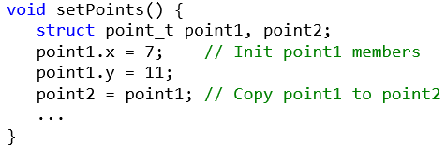
Dot Operator (.)
Used to access member variables
Syntax: structure_variable_name.member_name
These variables may be used like any other variables
Notes:
After you define a variable of a structure type, you can access the members by specifying the structure variable name, the dot operator, and then the member name. These qualified names can then be used just like other variables of that type.

Slide 7
Arrow Operator (->)
Used to access member variables using a pointer
Arrow Operator Syntax: structure_variable_pointer->member_name
Dot Operator Syntax: (*structure_variable_pointer).member_name
Notes:
If you have a pointer that points to a structure, you have the option of using the arrow operator or the dot operator. To use the arrow operator, you specify the pointer, the arrow operator (dash and greater-than), and the member name. To do the same thing with a dot operator, you specify star pointer within parentheses, the dot operator, and the member name.

Slide 8
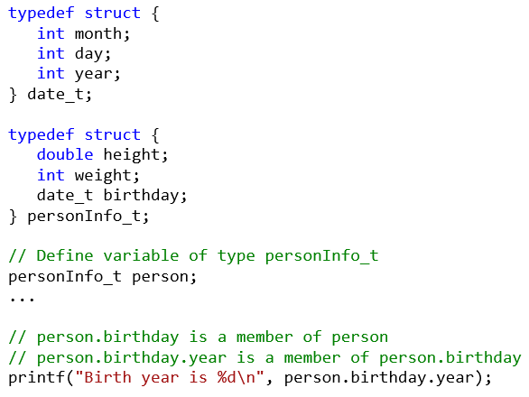
Nested Structures
A structure that contains a structure as a member
Notes:
Structures can be nested. They are nested when you have a member of a structure that is a structure type.

Slide 9
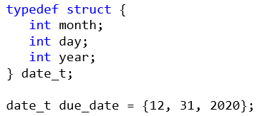
Initializing Structures
A structure may be initialized at the time it is declared
Order is essential
The sequence of values is used to initialize the successive variables in the struct
It is an error to have more initializers than members
If fewer initializers than members, the initializers provided are used to initialize the data members
The remainder are initialized to 0 for primitive types
Notes:
You can initialize a structure when it is declared in a manner similar to initializing the elements of an array. The member values are a comma separated value list enclosed in braces. You’ll get a syntax error if more initializers than members. If there are less than the number of members, the remaining that are primitive types will
be initialized to zero.
Can also use a compound literal to initialize a structure that has already been declared:
date_t finalDate;
// …
finalDate = (date_t){ 12, 7, 2016 };

Slide 10
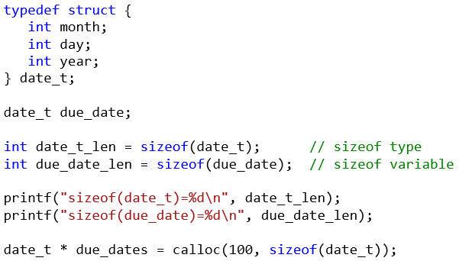
Dynamic Allocation of Structures
The sizeof() operator should always be used in dynamic allocation of storage for structured data types and in reading and writing structured data types
Notes:
The sizeof operator is most helpful when dynamically allocating a structure. You can use the sizeof operator on the structure type or a structure variable to determine the number of bytes of memory that the structure requires.

Slide 11
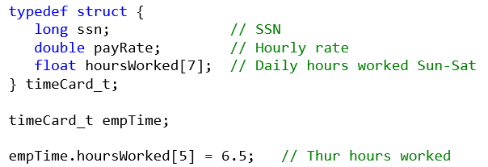
Arrays Within Structures
A member of a structure may be an array
Notes:
One or more members of a structure can be an array.
// Go over

Slide 12
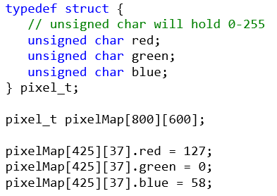
Arrays of Structures
We can also create an array of structure types
Notes:
You can have an array of elements that are structures.

Slide 13
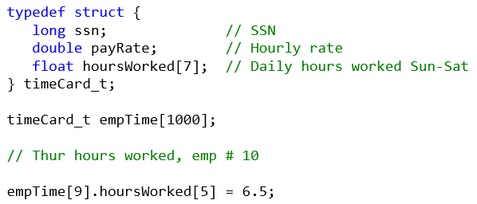
Arrays of Structures Containing Arrays
We can also create an array of structures that contain arrays
Notes:
You an also have an array of structures and the structure contains one or more embedded arrays.

Slide 14
Structures as Parameters
A struct, like an int, may be passed to a function
The process works just like passing an int, in that:
The complete structure is copied to the stack
Called function is unable to modify the caller's copy of the variable
Notes:
When you pass a structure to a function, the structure is passed by value, just as with other types such as int and float. That means that the structure must be copied and the function is not able to modify the original structure.

Slide 15
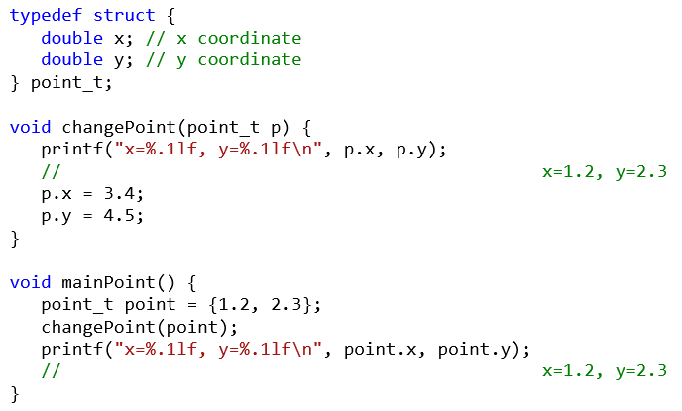
Structures as Parameters

Slide 16
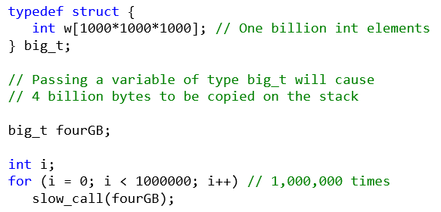
Structures as Parameters
Disadvantage of passing structures by value: Copying large structures onto stack
Is inefficient
May cause stack overflow
Notes:
If you pass a large structure to a function, it is inefficient and could cause a stack overflow if there isn’t enough room on the stack.
101/practice/structs/structParameter.c

Slide 17
Structure Pointers as Parameters
More efficient: Pass the address of the struct
Passing an address requires that only a single word be pushed on the stack, no matter the size
Called function can then modify the structure.
Notes:
You can get around the copying of a large structure or allow the function to modify the original structure. You do this by passing the address of the structure, simulating passing by reference. This is the same as we have seen for other data types.

Slide 18
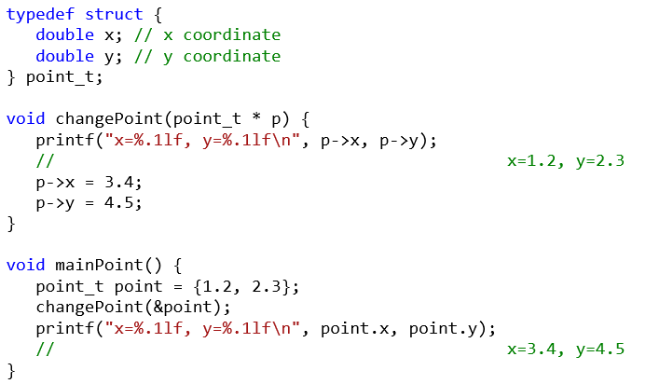
Structure Pointers as Parameters
Notes:
This is how we would modify the changePoint function to pass by reference.

Slide 19
Const Struct Parameter
What if you do not want the recipient to be able to modify the structure?
Use the const modifier
Notes:
If you want to get around the copying but don’t want the receiving function to be able to modify the structure parameter, you can specify the const keyword in the parameter.

Slide 20
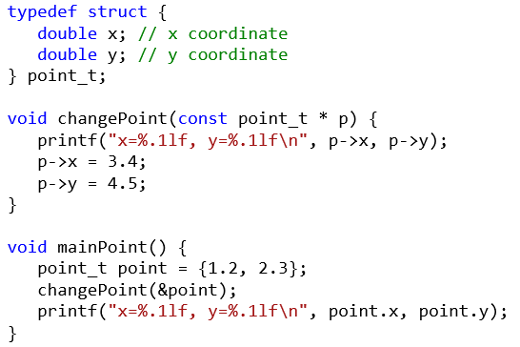
Using the const Modifier
Compile time errors:
ch08.c: In function âchangePointâ:
ch08.c:213:7: error: assignment of member âxâ in read-only object
ch08.c:214:7: error: assignment of member âyâ in read-only object
Notes:
Here we’ve taken the pass by reference example and added the const keyword. This code generates compile time errors because the parameters are designated as read-only constants.
// Show

Slide 21
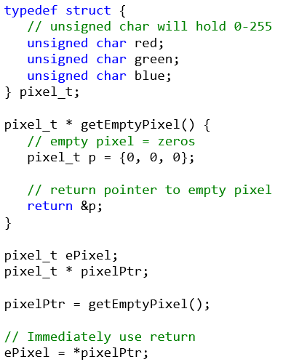
Return Structure Pointer to Local Variable
ch08.c: In function âgetEmptyPixelâ:
ch08.c:293:7: warning: function returns address of local variable
Notes:
You can dynamically allocate a structure and return a pointer to it. What happens if you return a pointer to a local structure variable?
// The memory pointed to by the returned pointer might be reused
101/practice/structPtrReturn.c with compile error
101/practice/structPtrReturn2.c fixed

Slide 22
Return Structure Pointer to Local Variable
Reason: function is returning a pointer to a variable that was allocated on the stack during execution of the function
Such variables are subject to being wiped out by subsequent function calls
Notes:
Since the memory may be reused, you better retrieve the structure quickly before it gets wiped out. You certainly be in danger if you called any other functions.

Slide 23
Function Return Structure Values
It is possible for a function to return a structure.
This facility depends upon the structure assignment mechanisms which copies one complete structure to another.
Avoids the unsafe condition associated with returning a pointer, but
Incurs the possibly extreme penalty of copying a very large structure
Notes:
In today’s C, you can return a structure. This involves copying the returned structure so you need to be aware of that penalty.

Slide 24
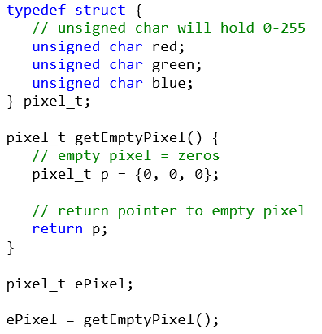
Function Return Structure Values
Notes:
If we modify our function to return this relatively small structure, we should be OK.
// Go over

Slide 25
Arrays as Parameters & Return
Array’s address is passed as parameter
Simulates passing by reference
Embedding array in structure
The only way to pass an array by value is to embed it in a structure
The only way to return an array is to embed it in a structure
Both involve copying
Beware of size
Notes:
We’ve seen how when you pass an array to a function as a parameter, C passes the address, simulating passing by reference. This means that the receiving function can modify elements in the array. The function could use the const keyword in the parameter which would mean that the function could not modify the array elements. But, suppose you wanted to allow the function to modify the passed array elements but not modify the original array, in other words, pass by value.
The only way that you can do that is to embed the array in a structure and then pass the structure. Remember that this involves copying the structure so you have to be concerned about size.
How would you return an array from a function? Not a pointer to an array but a locally defined array. The only way to do that is to embed it in a structure. Again since this involves copying the structure, size matters.

